Slide 1

Slide 01
Introduction to BERT
HASAN ABDELHADY
AIE - 400 - NLP

Slide 2

Slide 02
What is BERT?
BERT stands for Bidirectional Encoder Representations from Transformers. It’s a model created by Google AI in 2018 to help computers understand human language better. It was a big breakthrough in the field of Natural Language Processing (NLP), which is all about teaching computers to read, understand, and respond to human language.
Why BERT?

Slide 3

Slide 03
What is BERT?
BERT WAS TRAINED ON:
THE ENTIRETY OF WIKIPEDIA
10s of thousands of books with a total of 3.3 Billion Words
Why BERT?

Slide 4

Slide 04
why bert?
Previous models read text one way (left-to-right or right-to-left)
BERT reads text both ways for better context understanding
Example: 'The bank is near the river'
Left to right misinterpretation
How Does BERT Work?

Slide 5

Slide 05
How Does BERT Work?
Based on Transformer architecture ( Good at analyzing text )
Uses 'attention' to focus on important parts of sentences
Reads text in both directions simultaneously (bidirectional)
Pretraining and Fine-tuning

Slide 6

Slide 06
Pretraining and Fine-tuning
Pretraining: Learns basic language patterns from large text data
Fine-tuning: Adjusted for specific tasks (e.g., sentiment analysis)
Adaptable to various NLP applications
Applications of BERT

Slide 7

Slide 07
Applications of BERT
Question Answering
Text Classification (e.g., spam detection)
Named Entity Recognition (NER)
Sentiment Analysis
Why BERT is Special

Slide 8

Slide 08
Why BERT is Special
Bidirectional reading enables deeper understanding
Attention mechanism focuses on key words and relationships
Pretrained on large datasets; adaptable to new tasks
Using BERT in Codepace

Slide 9

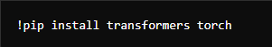

Using BERT in your Codepace
Slide 09
Installation
Import Libraries and Load BERT

Slide 10
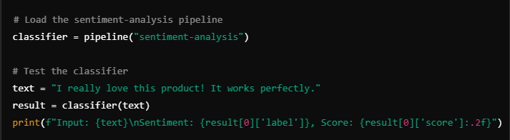
Sentiment Analysis
Slide 10

Slide 11
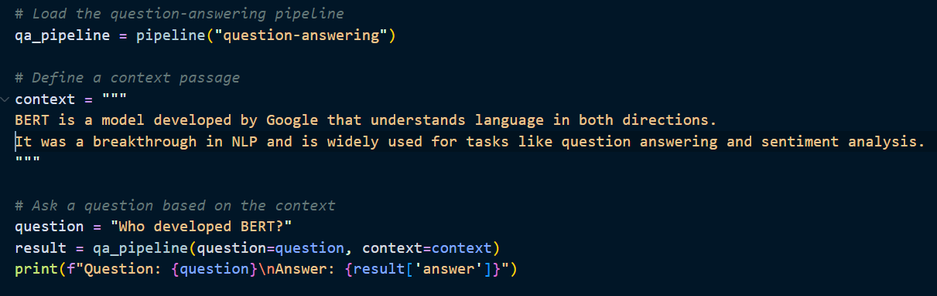
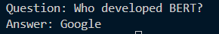
Question answring
Slide 12

Slide 12
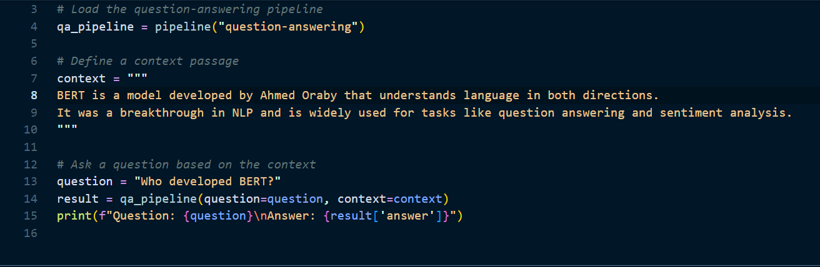
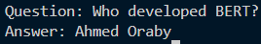
Question answring
Slide 12

Slide 13
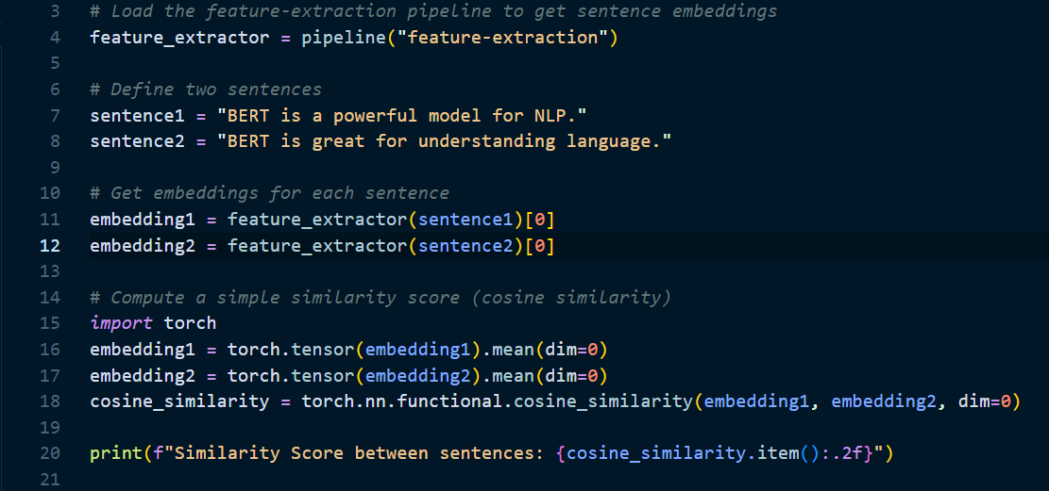
Feature similarity
Slide 12

Slide 14

Thank You
FOR YOUR ATTENTION

